Slide 1
Introduction to Networking and Omnet++
Cairo University Computer Networks-1 Faculty of Engineering CMP4020 Computer Department Fall 2024

Slide 2
Contact information
E-mail: Salma.cufece@gmail.com
Please don’t use Facebook or WhatsApp.
Office hours: Sundays from 2:30 to 4 pm.
Classroom :
Name: CMP4020_Fall_2024_networks_Semester
code: et4r4n6

Slide 3
Work Year Grades
(5) labs (5 marks) not all labs will be graded
Project (12 marks)
(2) quizzes (8 marks)
Midterm (15 marks)
Calendar link. (subject to changes)

Slide 4
Work Year Grades
(5) labs (5 marks) not all labs will be graded
Project (12 marks)
(2) quizzes (8 marks)
Midterm (15 marks)
Calendar link. (subject to changes)

Slide 5
Today’s Outline
Network Applications
Client Server and Peer to Peer Networks
Labs intended outcome
Introduction Omnet++
How to install
Tic Toc Demo
Lab 1 Requirement

Slide 6
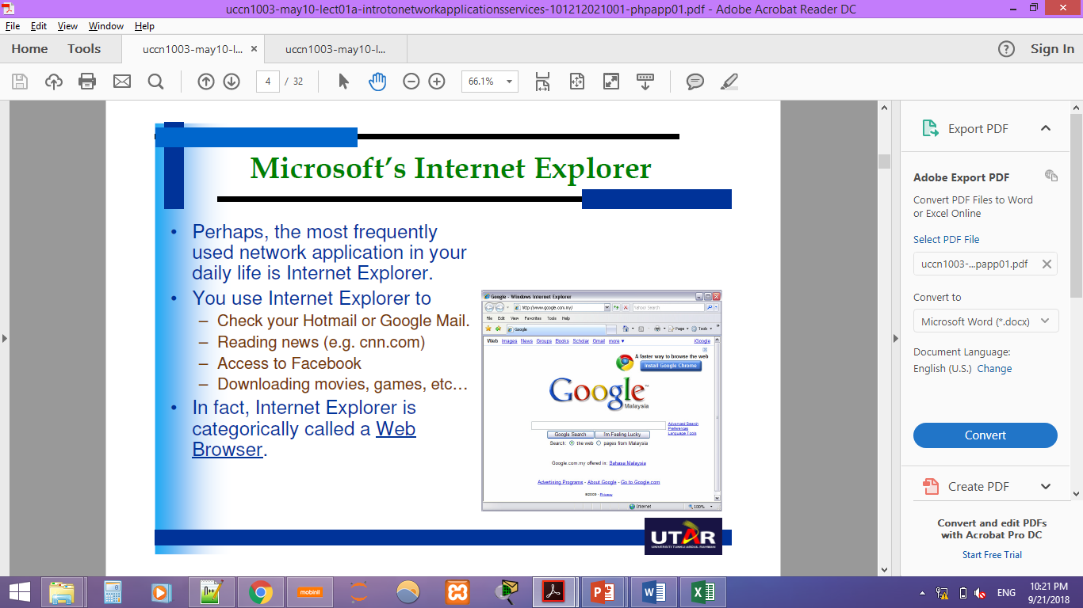
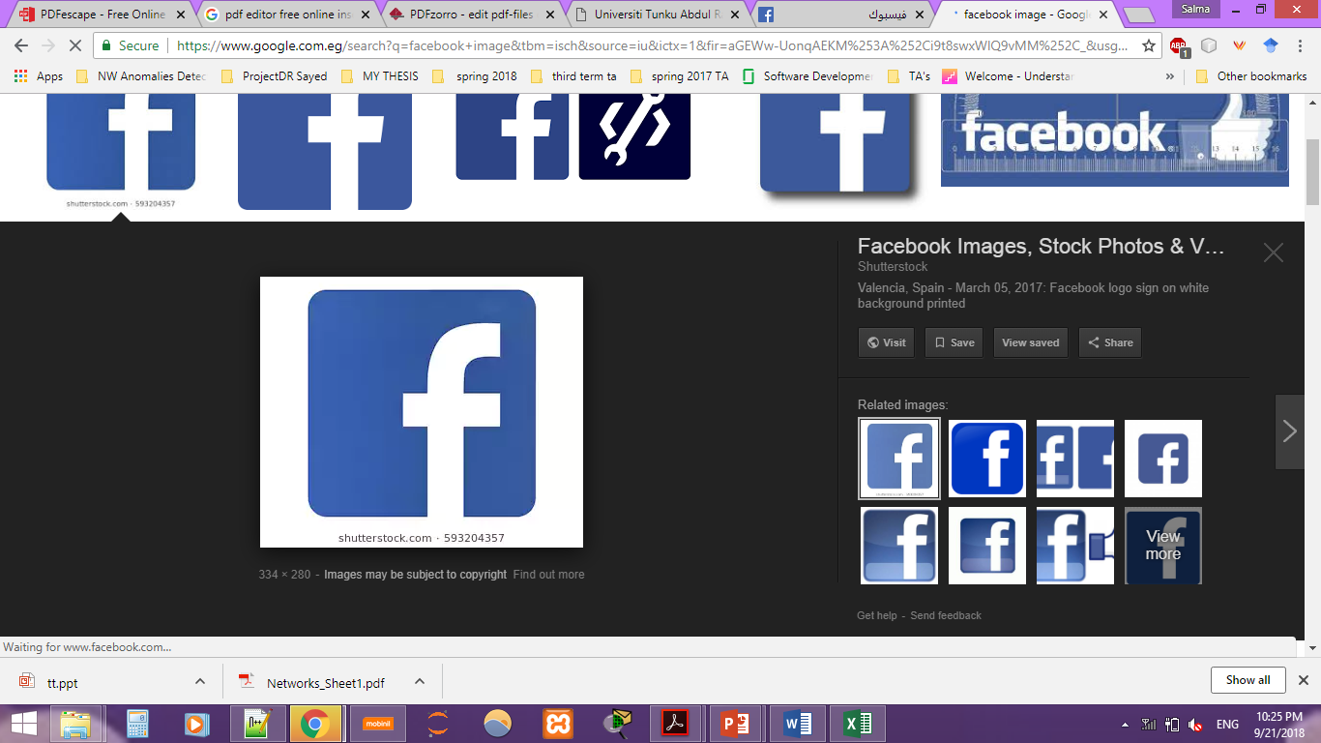
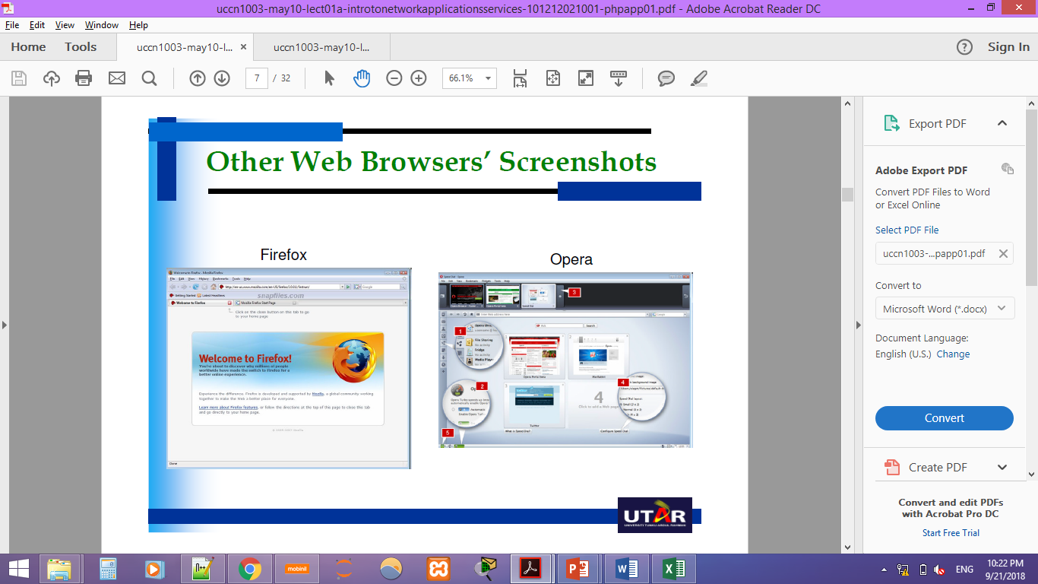
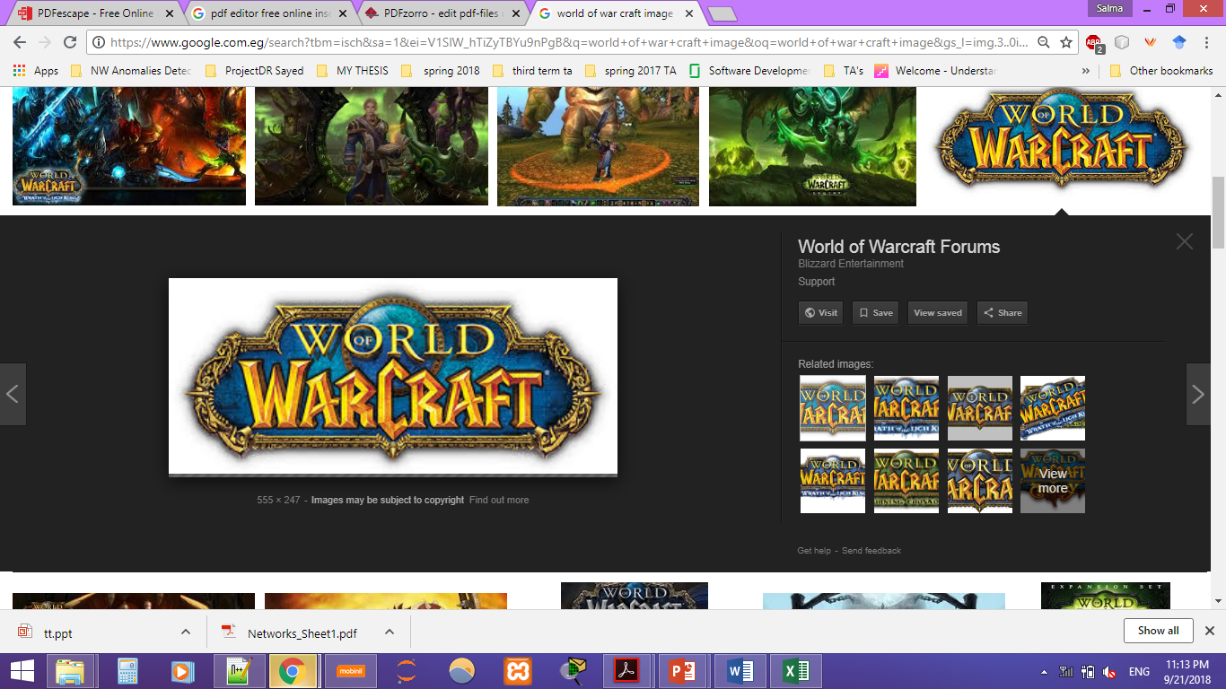
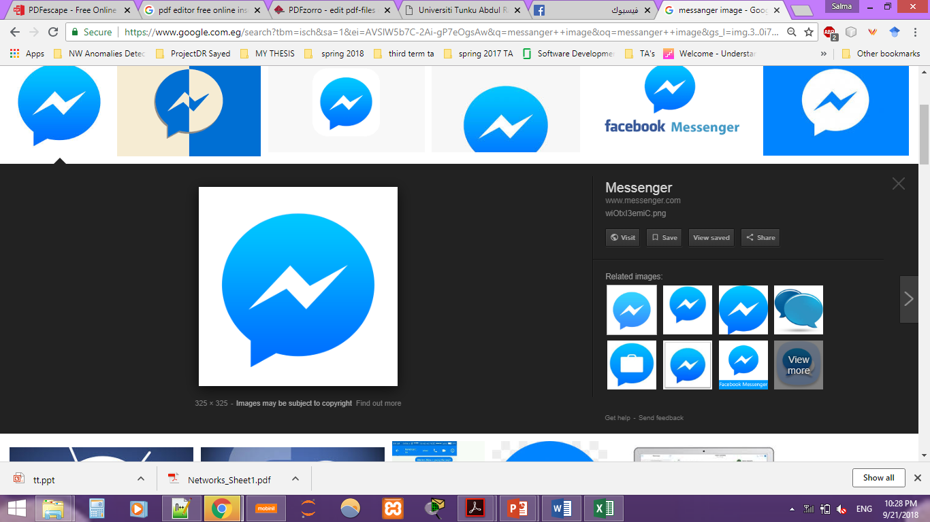
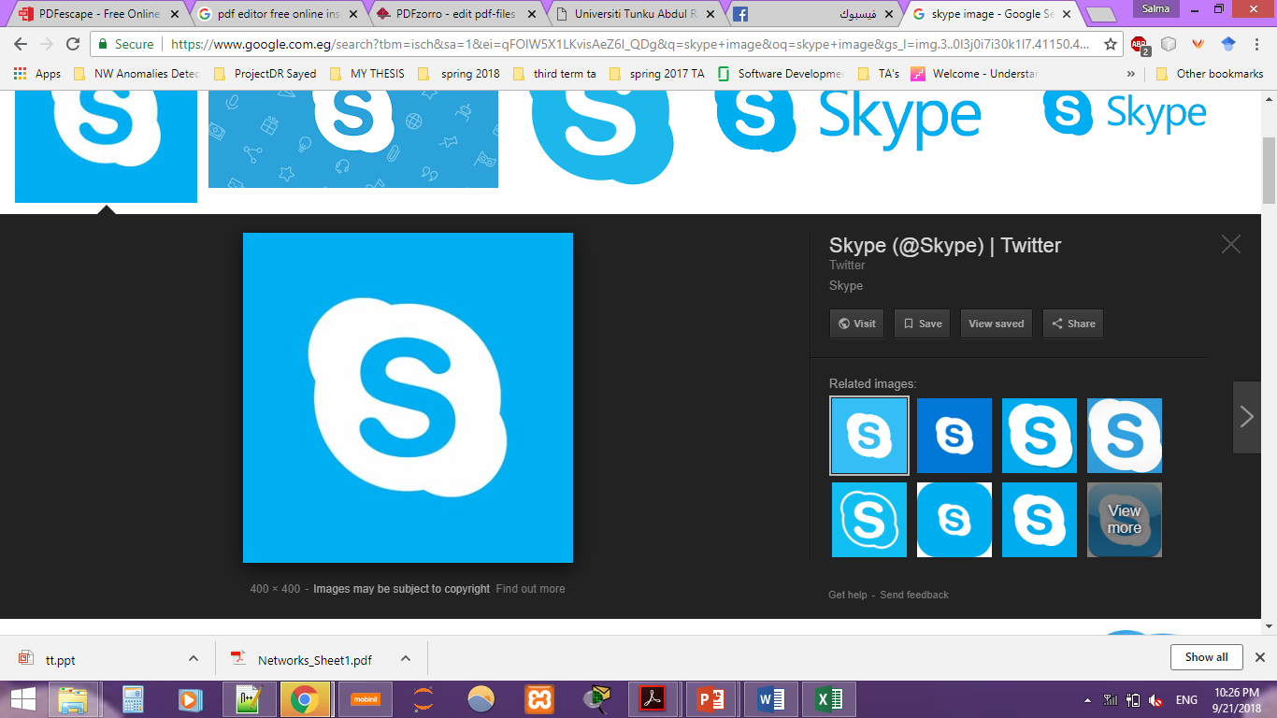
Network applications
When you access the Internet, do you use the following applications?
Since these applications require the access to the Internet, we refer to these applications as network applications.
They all access some form of remote information or resources
These network applications can be technically called as network client software.

Slide 7
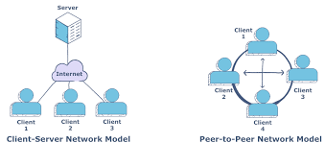
Server-Client vs Peer-Peer networks
Server-Client
Peer-Peer
Clients communicate with server.
Clients communicate with each others directly.
Each node is a client and a server.
Notes:
Image : https://www.educative.io/edpresso/what-are-p2p-and-clientserver-networks

Slide 8
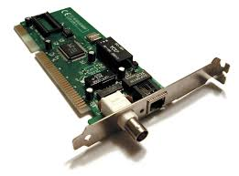
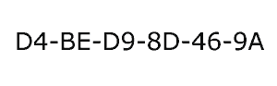
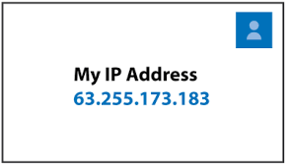
How Devices Communicate ?
Mac Address
Ip Address
Unique for each Network interface card (NIC) .
Used in LANs.
Usually Dynamic.
Necessary for any networks communication outside LANs.

Slide 9



Labs:
We will use Peer-Peer Networks in the labs to simulate data link layer and physical layers protocols.
Usually two nodes only.

Slide 10
Omnet++ [https://doc.omnetpp.org/omnetpp/manual/] Introduction
Discrete events simulator [not limited to network protocols simulation]
Hierarchically nested modules
Modules communicate using messages through channels
Basic machinery and tools to write simulations
Does not provide any components specifically for computer network simulations, queuing network simulations, system architecture simulations or any other area
Written in C++
Source code publicly available
Simulation model for Internet, IPv6, Mobility, etc. available
Free for academic use
Commercial version: OMNESTTM
Notes:
Some of the slides are adapted from An Introduction to OMNeT++ 4.5 by Christian Timmerer –Alpen Adria university October 2014

Slide 11
Omnet++
Models algorithms through C++ class library
Utility classes (for random number generation, statistics collection, topology discovery etc.)
⇨ Use it to create simulation components (simple modules and channels)
And it Describes the Topology using:
Network Description Language (NED)
.ini files
Eclipse-based simulation IDE for designing, running and evaluating simulations
Notes:
Some of the slides are adapted from An Introduction to OMNeT++ 4.5 by Christian Timmerer –Alpen Adria university October 2014

Slide 12
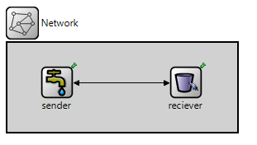
Omnet++ Component based architecture
Models assembled from reusable components = modules [building blocks]
Modules can be combined (like LEGO blocks) to form compound modules.
2
1
1

Slide 13
Omnet++ component based architecture
Modules can be connected with each other through gates [in, out, inout]
Channels are used to carry messages between the gates [delay, errors, …etc]
3
3
4

Slide 14

Omnet++ Hierarchical Modules
Modules are instances of module types.
Compound Modules include one or more modules.
Hierarchically nested modules.
The depth of module nesting is unlimited.
Simple modules at the lowest level of the module hierarchy.
did you call me ?

Slide 15
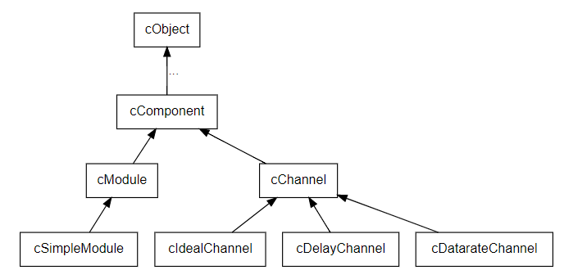
Omnet++ Hierarchical Modules
The user implements modules in C++ and the NED description.
Usually by inheriting from the cSimpleModule class

Slide 16
Omnet++ Hierarchical Modules
The user implements modules in C++ and the NED description.
Usually by inheriting from the cSimpleModule class
Basically override the functions:
initialize()
handleMessage(cMessage *msg)
Define the modules gates, parameters, and submodules in the .NED file.
Use the manual chapter 4.2 for your reference.
Notes:
Manual link: https://doc.omnetpp.org/omnetpp/manual/

Slide 17
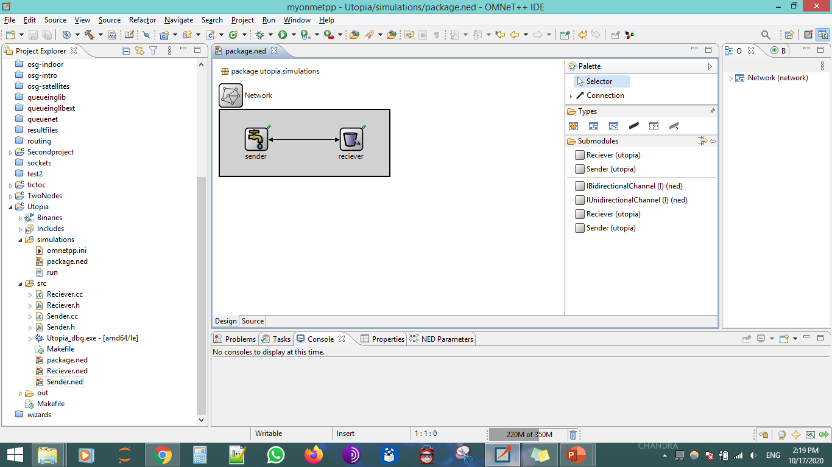
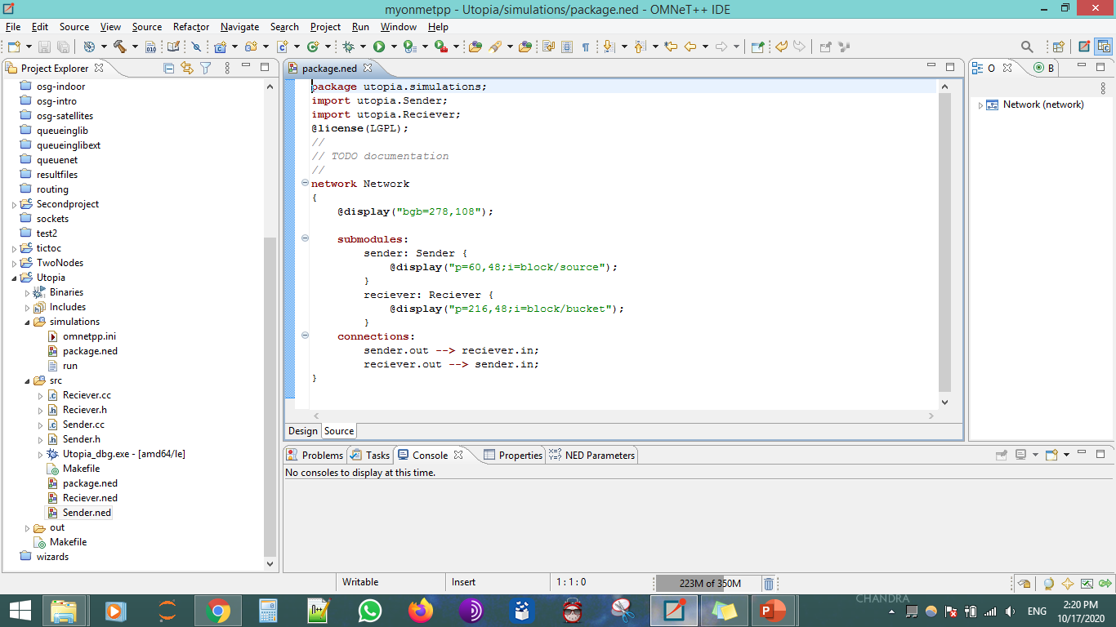
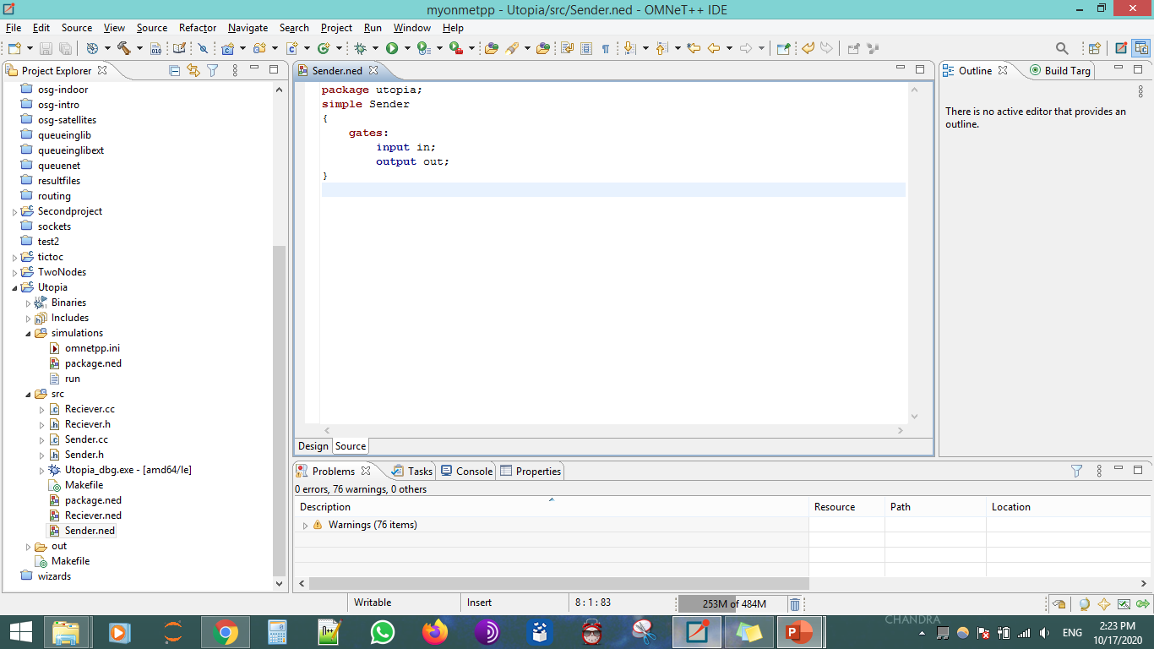
Omnet++ Hierarchical Modules Example
System Module

Slide 18
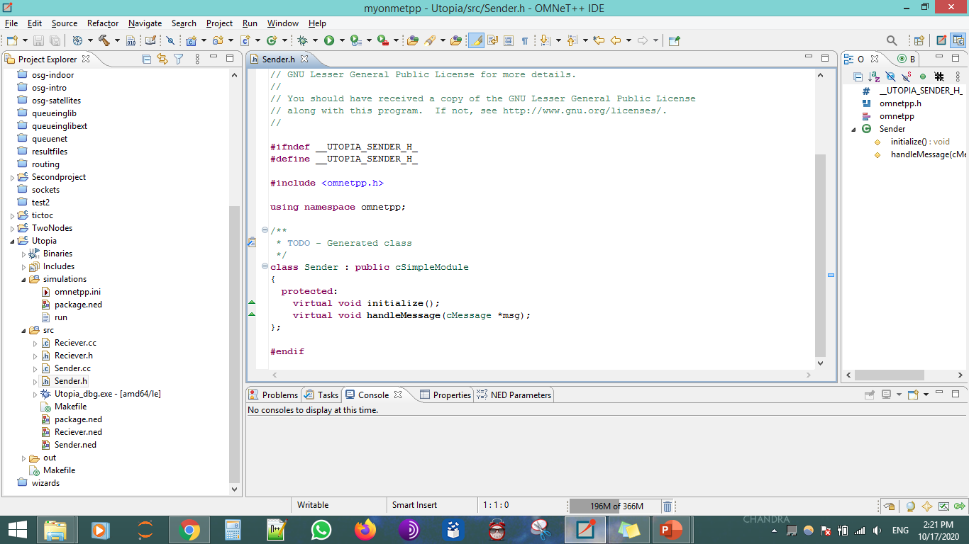
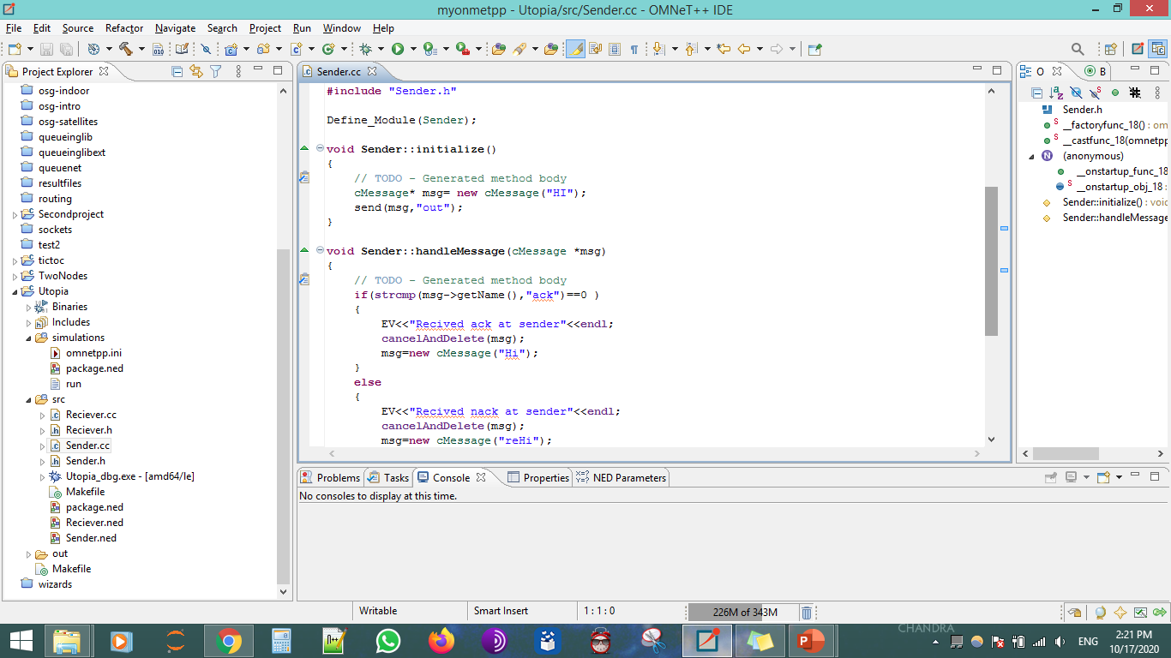
Omnet++ Hierarchical Modules Example

Slide 19
Omnet++ Hierarchical Modules
initialize()
This method is invoked after OMNeT++ has set up the network
handleMessage(cMessage *msg)
It is invoked with the message as parameter whenever the module receives a message. handleMessage() is expected to process the message, and then return.
finish()
is called when the simulation has terminated successfully
Notes:
Manual link: https://doc.omnetpp.org/omnetpp/manual/

Slide 20
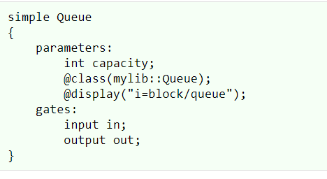
Omnet++ Hierarchical Modules
The .NED file name should be the same as the driven simple module C++ class.
Otherwise you should use the @class property.
Notes:
Manual link: https://doc.omnetpp.org/omnetpp/manual/

Slide 21
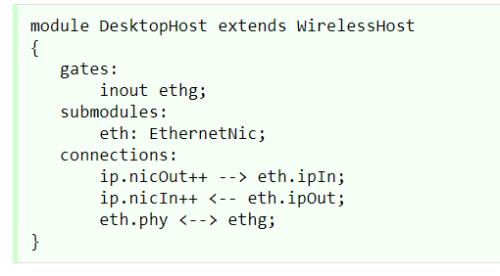
Omnet++ Hierarchical Modules
Compound Modules in .NED contains:
Types (optional)
Parameters (optional)
Gates (optional)
Submodules
connections
Notes:
Manual link: https://doc.omnetpp.org/omnetpp/manual/

Slide 22
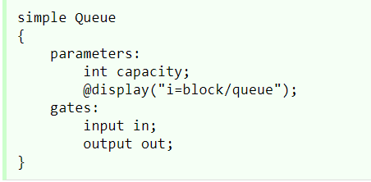
Omnet++ Hierarchical Modules
Simple Modules in .NED contains:
Parameters (optional)
Gates [ could be vectors of gates static or dynamic]
Notes:
Manual link: https://doc.omnetpp.org/omnetpp/manual/

Slide 23
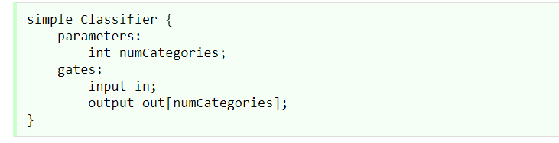
Omnet++ Gates
Gates types in .NED :
in
out
inout (not recommended)
Notes:
Manual link: https://doc.omnetpp.org/omnetpp/manual/

Slide 24
Omnet++ Connections
Connections cannot span across hierarchy levels.
Input and output gates are connected with a normal arrow
node0.gout-->node1.gin
Inout gates are connected with a double-headed arrow
Node0.ginout<-->Node1.ginout
When the ++ operator is used , it will increment the number of gates in the vector.
a.gout++ --> b.gin++;
Notes:
Manual link: https://doc.omnetpp.org/omnetpp/manual/

Slide 25
Omnet++ Messages
Messages objects represent events, packets, commands, jobs, customers …. etc.
Modules interact with each others though messages.
Events are generated, scheduled ,queued , invoked as message objects.
Messages are represented with the cMessage class and its subclass cPacket.
Notes:
Manual link: https://doc.omnetpp.org/omnetpp/manual/

Slide 26
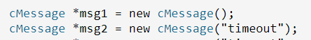
Omnet++ Messages
Define new Message
Duplicate Message
cMessage *copy = msg1->dup();
Notes:
Manual link: https://doc.omnetpp.org/omnetpp/manual/

Slide 27
Omnet++ Messages
Cancel and delete Message [ should always do that?]
cancelAndDelete(msg)
Don’t use messages after deleting them.
After this, the message pointer can be re allocated to another message.
Get message Name “content for now”
msg->getName()
We will visit this topic again later.
Use the manual chapter 5 for your reference.
Notes:
Manual link: https://doc.omnetpp.org/omnetpp/manual/

Slide 28
Omnet++ Extra Notes
Use the EV<<“hello”<<endl; in the c++ instead of cout for debugging.
Use getName() inside any module to get the instance name of it.
In the .ini file , don’t forget to include the system module name.
You can also assign global parameters in the .ini file.
Notes:
Manual link: https://doc.omnetpp.org/omnetpp/manual/

Slide 29
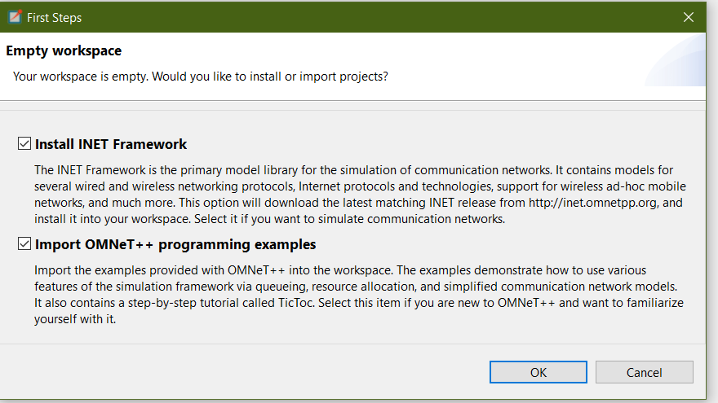
Omnet++ Installation
Install it inside the “C” drive to avoid any make errors.
Follow this short video to install the version(5.6.2) of Omnet++ from here .
When this screen shows, click ok and make sure that you have an internet connection on.
Link to today’s section record.
Notes:
Manual link: https://doc.omnetpp.org/omnetpp/manual/

Slide 30
Omnet++ Lab1 requirement
Using the same simple module for tic and toc, do the following :
Modify the Tic-Toc behavior so that :
Tic starts the conversation with the word “Hello from tic”
Toc responds with “Hello from toc”
Tic responds with “Tic_1”
Toc responds with “Toc_2”
………………. and so on
The last message to be sent should be “Toc_8”.
After that, Tic will respond with message “Goodbye from tic” ,
And Toc will respond with message “Goodbye from toc”.
Then the simulation terminates.
Notes:
Manual link: https://doc.omnetpp.org/omnetpp/manual/

Slide 31

Thank You !!

